Slide 1

PRIVATE EQUITY IN INDIA
BY: Niharika Chahar

Slide 2

WHAT IS PRIVATE EQUITY?
Private equity is a type of alternative investment that involves investing in privately held companies or acquiring public companies and delisting them. Private equity funds raise capital from institutional investors and high net worth individuals and use it to buy companies or make strategic investments. The goal is to improve the company's operations, increase its value, and sell it for a profit.

Slide 3
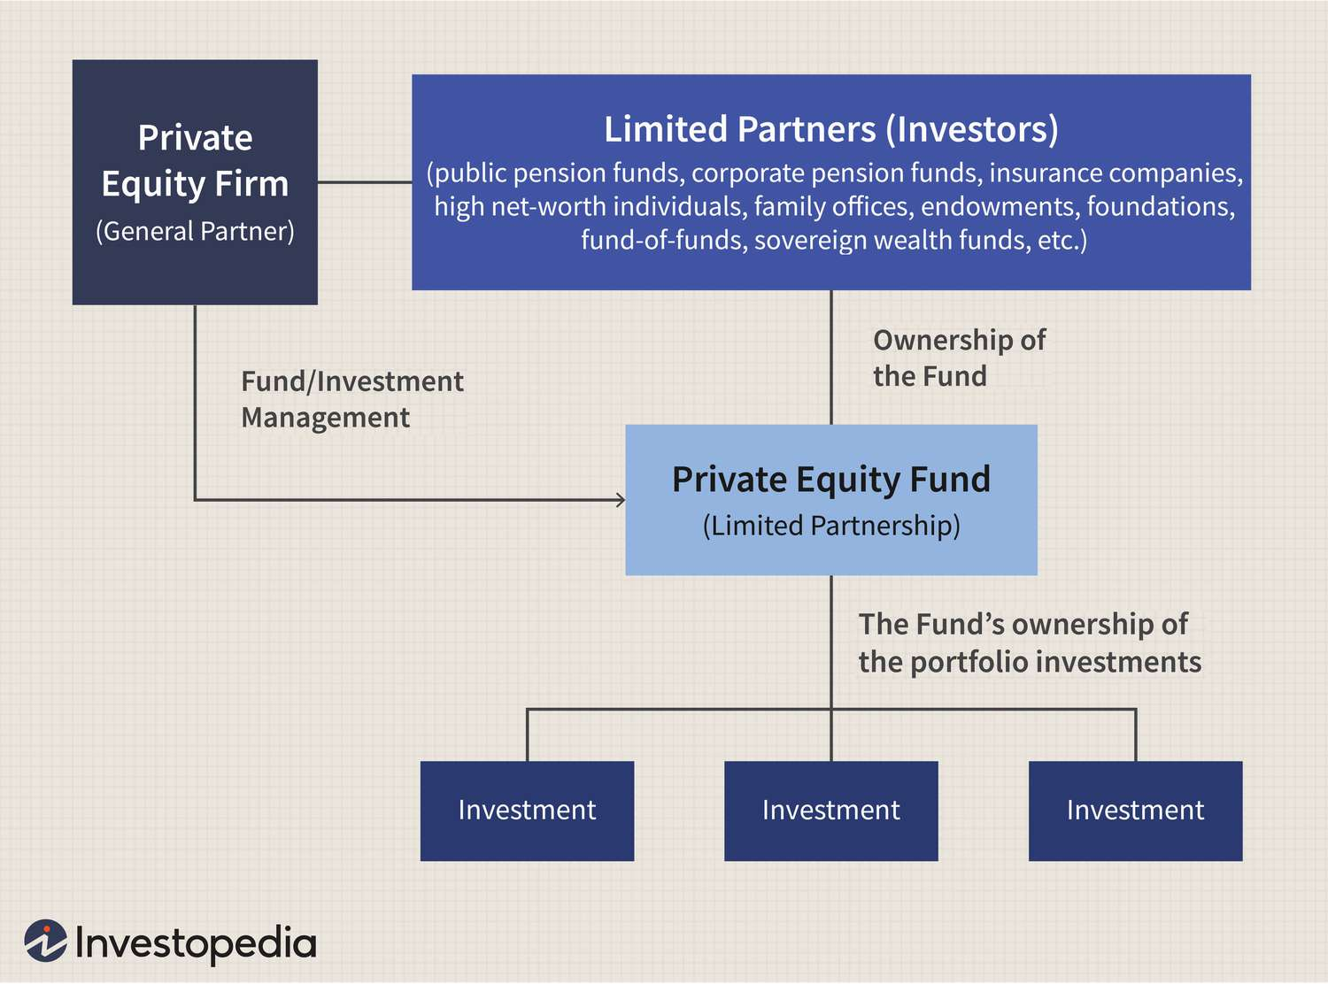
FORMATION OF A PE FUND

Slide 4
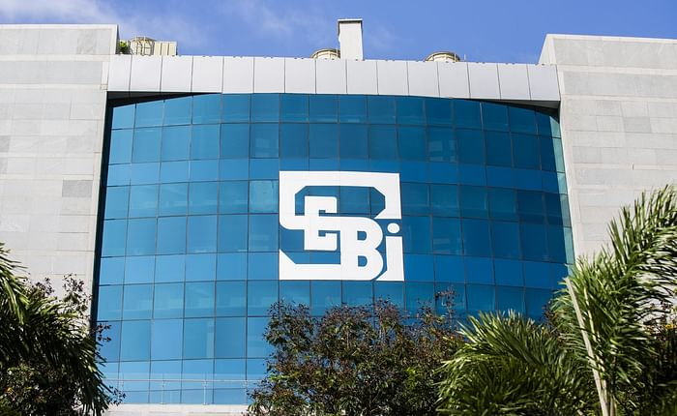
GUIDELINES FOR PE FUNDS IN INDIA
The Securities and Exchange Board of India (SEBI) regulates private equity funds and has issued guidelines for private placement of securities by such funds.
The guidelines require private equity funds to be registered with SEBI and to comply with various regulatory requirements such as disclosure norms, reporting requirements, and investment restrictions.
Private equity funds are required to have a minimum corpus of INR 20 crores (approximately $2.7 million) and a minimum of 20 investors.
The guidelines also specify that the investment in a single portfolio company by a private equity fund should not exceed 25% of the fund size.
Notes:
https://www.vccircle.com/sebi-sets-performance-benchmarking-norms-for-pe-vc-funds

Slide 5


ENTRY STRATEGIES OF PE FUNDS
Leveraged Buyout (LBO):
An LBO (leveraged buyout) is a type of acquisition where a company is bought with a significant amount of borrowed money, which is typically secured by the assets of the acquired company. Example: Blackstone acquired the entire 90.99% stake of the promoter group in CCD for approximately INR 3,000 crores (about $402 million). The acquisition was funded through a combination of equity and debt, with Blackstone contributing about 30% of the total amount in equity and the rest in debt financing.
Growth Capital:
Growth capital is a type of private equity investment made in companies that are expanding or require funds to reach their next level of growth.
Example: Warburg Pincus' investment of $100 million in boAt, a Mumbai-based consumer electronics company that sells audio equipment such as earphones, headphones, and speakers.
Notes:
https://www.bloomberg.com/news/articles/2020-02-26/blackstone-is-said-to-proceed-to-acquire-coffee-day-s-tech-park-k7346qln#xj4y7vzkg The debt was raised from a consortium of banks led by Axis Bank and included ICICI Bank, Standard Chartered Bank, and Yes Bank. https://warburgpincus.com/2021/01/05/warburg-pincus-to-invest-100-million-in-boat-indias-1-brand-in-the-personal-audio-category/

Slide 6


CONTINUED
Distressed Debt:
Distressed debt is a strategy used by private equity funds to invest in the debt of companies experiencing financial difficulties or at risk of default.
Example: In 2021, Oaktree Capital Management acquired 51% stake in Dewan Housing Finance Corporation Limited (DHFL), an Indian housing finance company that had defaulted on its debt obligations, for a total consideration of around $442 million.
PIPE (Private Investment in Public Equity):
PIPE is a type of investment where private investors buy shares of a publicly traded company, often at a discount to the market price, directly from the company or from other existing shareholders.
Example: In May 2021, Carlyle and GIC agreed to invest around $300 million in PNB Housing Finance Ltd. through a combination of primary infusion and secondary purchase from existing shareholders.
Notes:
https://www.livemint.com/companies/news/oaktree-capital-emerges-highest-bidder-for-dewan-housing-finance-11607958566541.html https://economictimes.indiatimes.com/industry/banking/finance/cci-okays-carlyle-groups-rs-4000-crore-investment-in-pnb-housing-finance/articleshow/85034986.cms?from=mdr

Slide 7


CONTINUED
6. Secondary Market:
Secondary market entry strategy by PE funds involves buying existing shares from the market or shareholders, rather than investing in the company directly.
Example: Acquisition of a 40% stake in Sembcorp Energy India Limited by The Chatterjee Group (TCG) in May 2021 from its existing private equity investor, the Oman India Joint Investment Fund (OIJIF), for approximately $300 million.
7. Platform Build: Platform build is an entry strategy by private equity funds where they acquire and integrate multiple companies within a specific industry or sector to create a larger, more efficient entity.
Example: Kedaara Capital's acquisition of Vishal Mega Mart in 2015, followed by subsequent acquisitions of other retail chains such as Nilgiri's and the merger of all these entities to form the "V Mart" retail chain.
Notes:
https://www.vccircle.com/tag/platform-investing

Slide 8


EXIT STRATEGIES OF PE FUNDS
Initial Public Offering (IPO):
PE funds can exit their investments through an IPO when the company goes public. In 2021, there were 15 PE-backed IPOs in India, raising a total of $2.8 billion. Examples include:
Example: PE firm Warburg Pincus-backed Kalyan Jewelers went public in March 2021, raising Rs 1,175 crore ($161 million) through its IPO.
Strategic Sale:
PE funds can sell their stake to another company in the same industry or a competitor.
Example: Sale of Home First Finance Company (HFFC) by Warburg Pincus to private lender Kotak Mahindra Bank in February 2021. Warburg Pincus had invested in HFFC in 2017 and helped the company grow its retail home loan portfolio. The deal was valued at around INR 1,153 crore ($158 million) and Warburg Pincus reportedly earned a return of over 3x on its investment.
Notes:
1. https://www.nasdaq.com/articles/warburg-pincus-backed-indias-kalyan-jewellers-seeks-$160-mln-in-ipo-2021-03-11 Laxmi Organic Industries: Laxmi Organic Industries, which counts PE firm BanyanTree Growth Capital among its investors, went public in March 2021. The specialty chemicals maker raised Rs 600 crore ($82 million) through its IPO, offering shares at a price band of Rs 129-130. The company had a market capitalization of around Rs 3,000 crore ($410 million) at the time of listing.
Barbeque Nation: Barbeque Nation Hospitality, backed by PE firm CX Partners, went public in April 2021. The restaurant chain raised Rs 452 crore ($62 million) through its IPO, offering shares at a price band of Rs 498-500. The company had a market capitalization of around Rs 2,000 crore ($273 million) at the time of listing.
Sona BLW Precision Forgings: Automotive components maker Sona BLW Precision Forgings, which counts PE firm Blackstone among its investors, went public in June 2021. The company raised Rs 5,550 crore ($760 million) through its IPO, offering shares at a price band of Rs 285-291. The company had a market capitalization of around Rs 18,000 crore ($2.5 billion) at the time of listing.
2. https://www.financialexpress.com/market/ipo-news/warburg-pincus-ups-stake-in-home-first-finance-ahead-of-rs-1000-cr-ipo/2170758/

Slide 9
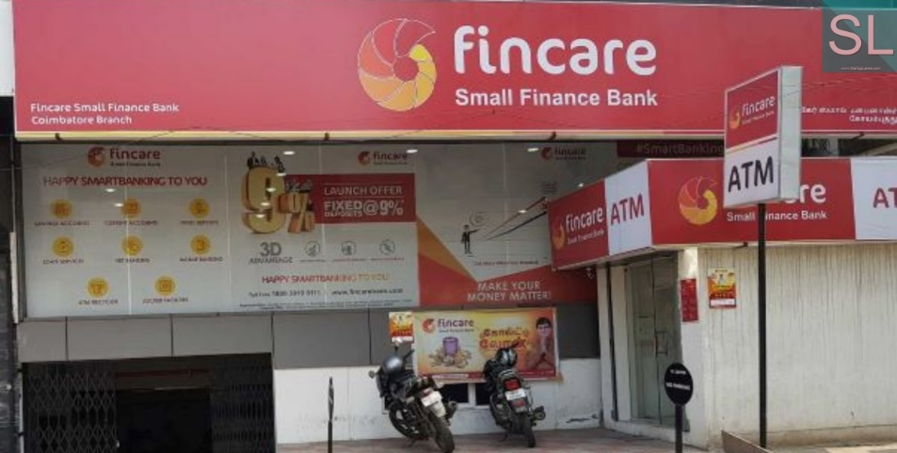
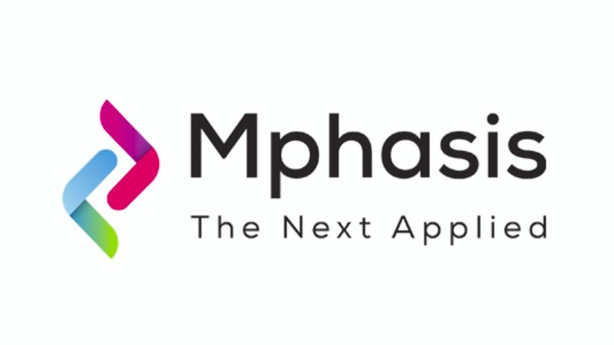
CONTINUED
Secondary Sale:
PE funds can sell their stake to another PE fund or a financial institution. In 2021, there were several secondary sales in India by PE funds, including:
Example: True North's sale of its stake in Fincare Small Finance Bank to TA Associates for $220 million.
Recapitalization: PE funds can recapitalize the company by replacing the existing debt with equity or issuing new equity. In 2021, there were several examples of recapitalization by PE funds in India, including:
Example: Baring Private Equity Asia's investment of $100 million in Mphasis, which included $60 million in primary capital for the company's growth and $40 million to buy out the stake of a co-founder.
Notes:
https://economictimes.indiatimes.com/industry/banking/finance/banking/true-north-exits-fincare-sfb-sells-stake-to-ta-associates/articleshow/82898313.cms
Gaja Capital's sale of 14% stake in John Distilleries to Sequoia Capital India for $23 million
2. https://www.livemint.com/companies/news/baring-pe-asia-to-invest-100-mn-in-mpahsis-for-co-founder-buyout-11606703993278.html

Slide 10

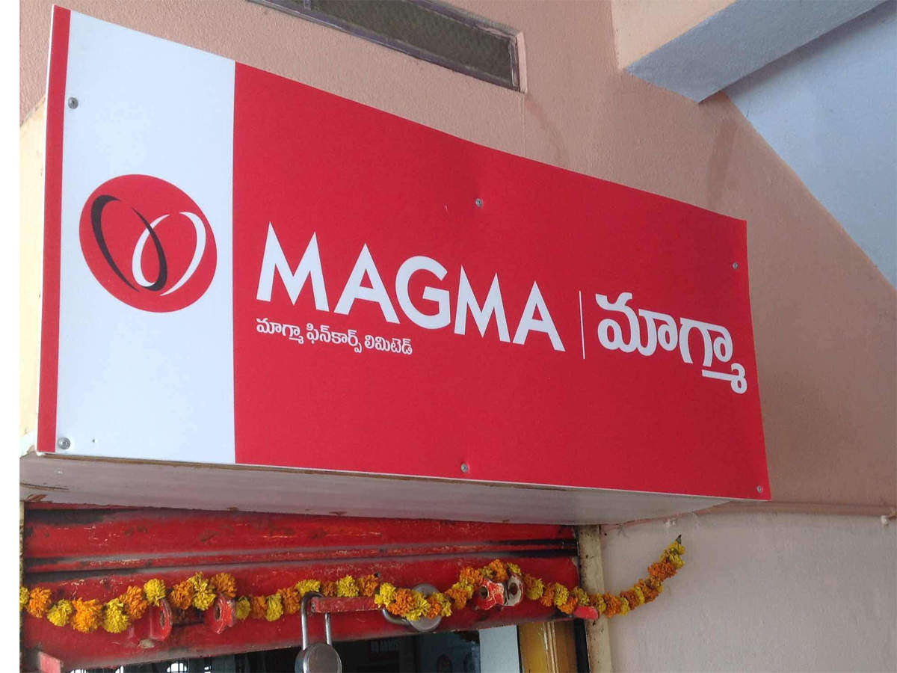
CONTINUED
5. Management Buyout (MBO):
PE funds can sell the portfolio company to its management team, who typically use a combination of debt and equity financing to acquire the company. Example: Acquisition of Healthium Medtech, a medical devices company, by Apax Partners. In this transaction, Apax Partners acquired a controlling stake in Healthium Medtech from TPG Capital and CX Partners, and the existing management team also participated in the buyout. The deal was reportedly worth around $480 million.
6. Dividend Recapitalization:
PE funds can distribute cash to investors by raising additional debt to pay a special dividend or by selling a portion of their shares to the portfolio company. Dividend recapitalizations can provide immediate returns, but may increase the company's leverage and reduce its financial flexibility.
Example: In February 2021, KKR-backed Indian non-banking financial company (NBFC) Magma Fincorp announced a dividend payout of INR 115 crore ($15.6 million) to its shareholders, which included KKR. This dividend payout was a result of a dividend recapitalization, which allowed Magma Fincorp to distribute excess cash to its shareholders.
Notes:
https://economictimes.indiatimes.com/industry/healthcare/biotech/healthcare/apax-partners-to-acquire-controlling-stake-in-healthium-medtech-for-480-mn/articleshow/81919010.cms

Slide 11
PRIVATE EQUITY VS VENTURE CAPITALIST
S.NO. | MODE OF DIFFERENCE | VENTURE CAPITALIST | PRIVATE EQUITY
1. | Stage of Investment | VC funds in India typically invest in early-stage and growth-stage companies. In 2021, 81% of VC investments were made in early-stage. | PE funds focus on growth-stage and mature companies. while 70% of PE investments were made in growth-stage companies.
2. | Investment Size | INR 2-50 crores ($0.3-7 million). | INR 100-500 crores ($14-70 million).
3. | Risk Profile | The failure rate for VC-backed startups in India was around 30% in 2021. | While the failure rate for PE-backed companies was around 10%.
4. | Time Horizon | 3-5 years. | 7-10 years.
5. | Exit Strategies | VCs typically exit their investments through strategic sales or secondary sales. | while PEs may use IPOs, strategic sales, secondary sales, or dividend recapitalizations.
Notes:
SOURCES: EY India Private Equity Quarterly Deals Tracker
Venture Intelligence India Private Equity and Venture Capital Report https://www.ventureintelligence.com/weekly-sample.htm
NASSCOM-Zinnov Start-up Ecosystem Report
https://zinnov.com/innovation/zinnov-nasscom-india-tech-start-up-landscape-report-2022/#:~:text=The%20India%20Start%2Dup%20ecosystem,in%20the%20last%20decade%20alone. 3. Preqin Private Equity and Venture Capital India Report
https://www.preqin.com/insights/research/factsheets/indian-private-equity-and-venture-capital-a-preqin-and-ivca-factsheet

Slide 12
PRIVATE EQUITY VS HEDGE FUNDS
S.NO. | MODE OF DIFFERENCE | HEDGE FUNDS | PRIVATE EQUITY
1. | Investment Strategy | Hedge funds typically invest in a wide range of assets such as stocks, bonds, commodities, currencies, and derivatives, with the objective of generating absolute returns irrespective of market conditions. | On the other hand, private equity funds focus on acquiring ownership stakes in private companies with the aim of improving their performance and value before selling them for a profit.
2. | Investment Horizon | Short investment horizon may hold positions for days, weeks, or months. | Long investment horizon 7-10 years.
3. | Risk | High risk | Relatively less risk
4. | Regulatory Oversight | Less regulated | More regulated
5. | Market Size | In India (AUM) of hedge fund is around $3.5 billion as of 2020. | The private equity industry in India is estimated to be worth around $54 billion as of 2021.
Notes:
Hedge funds employ strategies that are more risky than those used by private equity funds.
Private equity funds, on the other hand, invest in private companies and have greater control over the investment, which reduces the risk.

Slide 13
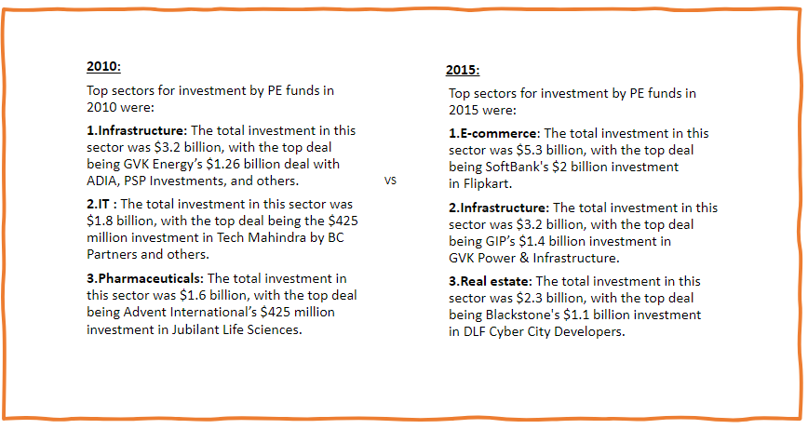
FAVOURITE SECTORS FOR INVESTMENT BY PE FUNDS: PAST, PRESENT & FUTURE
2010:
Top sectors for investment by PE funds in 2010 were:
Infrastructure: The total investment in this sector was $3.2 billion, with the top deal being GVK Energy’s $1.26 billion deal with ADIA, PSP Investments, and others.
IT & ITeS: The total investment in this sector was $1.8 billion, with the top deal being the $425 million investment in Tech Mahindra by BC Partners and others.
Pharmaceuticals: The total investment in this sector was $1.6 billion, with the top deal being Advent International’s $425 million investment in Jubilant Life Sciences.
2015:
Top sectors for investment by PE funds in 2015 were:
E-commerce: The total investment in this sector was $5.3 billion, with the top deal being SoftBank's $2 billion investment in Flipkart.
Infrastructure: The total investment in this sector was $3.2 billion, with the top deal being GIP’s $1.4 billion investment in GVK Power & Infrastructure.
Real estate: The total investment in this sector was $2.3 billion, with the top deal being Blackstone's $1.1 billion investment in DLF Cyber City Developers.

Slide 14
CONTINUED
2020:
Top sectors for investment by PE funds in 2020 were:
1. Technology: According to a report by Bain & Company, the technology sector in India received the highest private equity investments in 2020, with $11.5 billion invested across 459 deals.
Blackstone: The private equity giant made a $1.2 billion investment in Indian IT services company Mphasis in April 2020, acquiring a majority stake in the company.
2. Financial Services: Private equity and venture capital firms invested around $9.3 billion in the financial services sector in India in 2020.
Example: Warburg Pincus investment of INR 700 crore ($93.4 million) in India First Life Insurance.
3. Healthcare: Private equity and venture capital firms invested $3.1 billion in the Indian healthcare sector in 2020. This includes investments in areas such as pharmaceuticals, hospitals, diagnostics, and medical devices.
True North's investment in Biocon Biologics: True North acquired a 2.44% stake in Biocon Biologics, the biosimilars unit of Biocon, for around $100 million.
Notes:
Top sectors for investment by PE funds in 2020 in India: https://www.businesstoday.in/current/corporate/top-sectors-for-investment-by-pe-funds-in-2020/story/426147.html
Top PE deals in financial services sector in 2020: https://www.vccircle.com/top-5-pe-deals-of-2020-in-financial-services-sector
Total investment by PE and VC firms in 2020 in India: https://www.business-standard.com/article/markets/private-equity-investment-in-india-may-touch-a-new-high-in-2020-120123000426_1.html
Total investment by PE firms in 2020 in India: https://economictimes.indiatimes.com/industry/banking/finance/pe-investment-in-india-declined-30-yoy-in-value-terms-in-2020-report/articleshow/80353754.cms
ICICI Securities acquisition of Axis Capital's investment banking business: https://economictimes.indiatimes.com/markets/stocks/news/icici-securities-acquires-axis-capitals-investment-banking-business/articleshow/77891235.cms
Warburg Pincus investment in India First Life Insurance: https://www.thehindubusinessline.com/money-and-banking/warburg-pincus-invests-93-mn-in-india-first-life-insurance/article32906567.ece

Slide 15
CONTINUED
Future:
Technology and software: With the rapid digitization of various industries, the technology and software sector is expected to grow significantly in the coming years. According to a report by EY, the Indian technology sector is expected to reach a market size of $1 trillion by 2025, making it an attractive investment opportunity for private equity funds.
Healthcare: The Indian healthcare sector is also growing rapidly, with increasing demand for quality healthcare services and products. Private equity funds are showing increasing interest in healthcare startups and companies that offer innovative healthcare solutions.
Renewable Energy: With the Indian government's focus on renewable energy and the increasing demand for clean energy solutions, the renewable energy sector is expected to see significant growth in the coming years. According to a report by IBEF, the renewable energy sector in India is expected to reach a capacity of 175 GW by 2022. Private equity funds are investing in renewable energy startups and companies that offer innovative and sustainable solutions.

Slide 16


The changes in Private Equity Fund’s strategy in India over the years:
1. Focus on early-stage investing:
In the early years, PE funds in India primarily focused on growth-stage and buyout investments.
Swiggy: Accel Partners India invested in Swiggy, the food delivery company in India, in 2015 when the company was in its early stages. Swiggy has since become a market leader in the highly competitive food delivery industry in India and has raised over $1.7 billion in funding to date.
2. Sectoral diversification:
PE funds investing in sectors such as healthcare, edtech, e-commerce, Fintech, IT and services.
KKR: Another global PE firm, KKR has invested in a diverse range of sectors in India, including healthcare, consumer goods, energy, and infrastructure. Some of KKR's notable investments in India include Max Financial Services and Coffee Day Enterprises.

Slide 17

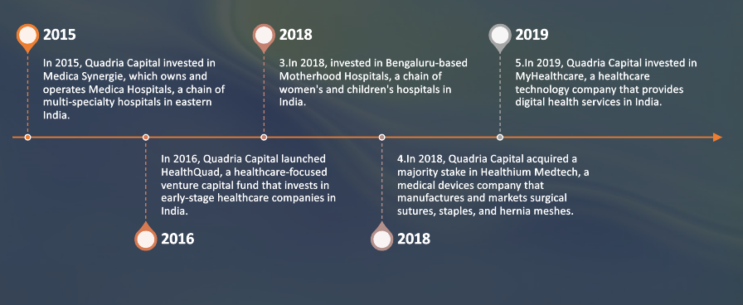
CONTINUED
3. Rise of sector-focused funds:
With the growing diversification of sectors, there has been a rise in sector-focused funds in India.
Healthcare has emerged as a key sector for PE investments in recent years, with several sector-focused funds investing in healthcare companies in India.

Slide 18
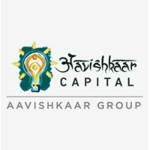



CONTINUED
4. Increased emphasis on ESG:
Environmental, social, and governance (ESG) considerations have become increasingly important for PE funds in recent years.
Example: Aavishkaar Capital, this is a Mumbai-based impact investment firm that invests in companies that create social and environmental impact in India.
5. Co-investing and syndication:
Co-investing and syndication have become popular among PE funds in India as they seek to reduce risk and diversify their portfolios.
Example: In 2021, Everstone Capital, an Indian PE firm, collaborated with Goldman Sachs and the Canada Pension Plan Investment Board (CPPIB) to acquire a controlling stake in Rubicon Research, an Indian pharmaceutical company.

Slide 19
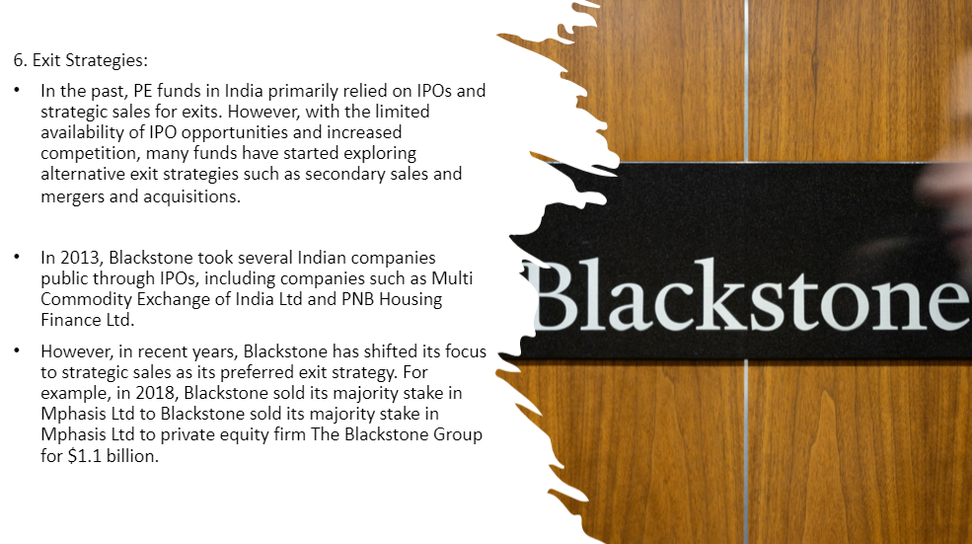
CONTINUED
Notes:
https://economictimes.indiatimes.com/news/company/corporate-trends/how-blackstone-turned-india-into-its-most-profitable-market/articleshow/63264408.cms?from=mdr Emcure Pharmaceuticals: Blackstone invested in this pharma company in 2010 and exited through a partial stake sale to Bain Capital in 2017.
Nucleus Software: Blackstone invested in this software company in 2014 and exited through a secondary sale to funds managed by Morgan Stanley Private Equity in 2019.

Slide 20

INTERESTING FACTS ABOUT PE IN INDIA
The first PE fund in India was set up in 1986, called the “Indocean Venture Capital Corporation.”
The PE industry in India has grown significantly over the past two decades, with the number of PE funds increasing from 15 in 2000 to over 370 in 2020.
The total value of PE deals in India has grown from $2.2 billion in 2005 to $48 billion in 2020, demonstrating a significant increase in investment activity.
The technology sector has been the most popular destination for PE investments in India over the past decade, followed by healthcare and consumer goods and services.
Mumbai is the primary hub for PE investment activity in India, followed by Bangalore and Delhi.

Slide 21

CONTINUED
Private equity funds in India are increasingly focusing on smaller ticket sizes, with a growing number of funds targeting investments in the range of $10-25 million.
There has been a growing trend towards longer investment horizons in India, with many funds looking to invest over a 7-10 year period, compared to the previous norm of 4-5 years.
India has emerged as one of the top destinations for PE investments in Asia, with a large pool of high-quality startups and a growing consumer market.
The regulatory environment for PE funds in India has improved significantly over the years, with the introduction of several new regulations aimed at improving transparency and increasing investor protection.

Slide 22

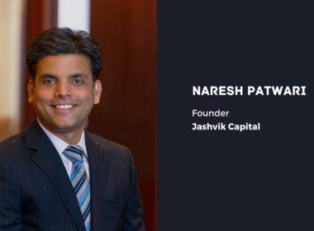
JASHVIK CAPITAL
Jashvik Capital is a private equity firm based in Mumbai, India.
Jashvik Capital was founded by Naresh Patwari, a former executive at Boston-based private equity firm TA Associates, in July 2022.
His company is registered with SEBI as a Category II Alternative Investment Fund and with IFSCA as a Fund Management Entity.
Jashvik Capital is a private equity firm that focuses on investing in mid-market healthcare and consumer sector-focused companies in India.
Jashvik Capital launched its maiden fund in July 2022 and aims to raise $350 million, with a hard cap of $400 million
Notes:
As for its strategy, the firm invests in profitable businesses growing at a rate of over 18% in large, addressable markets in healthcare or pharma and consumer sectors in India. It seeks to partner with exceptional founders and help them accelerate growth and make their businesses resilient and future ready, a statement said.

Slide 23
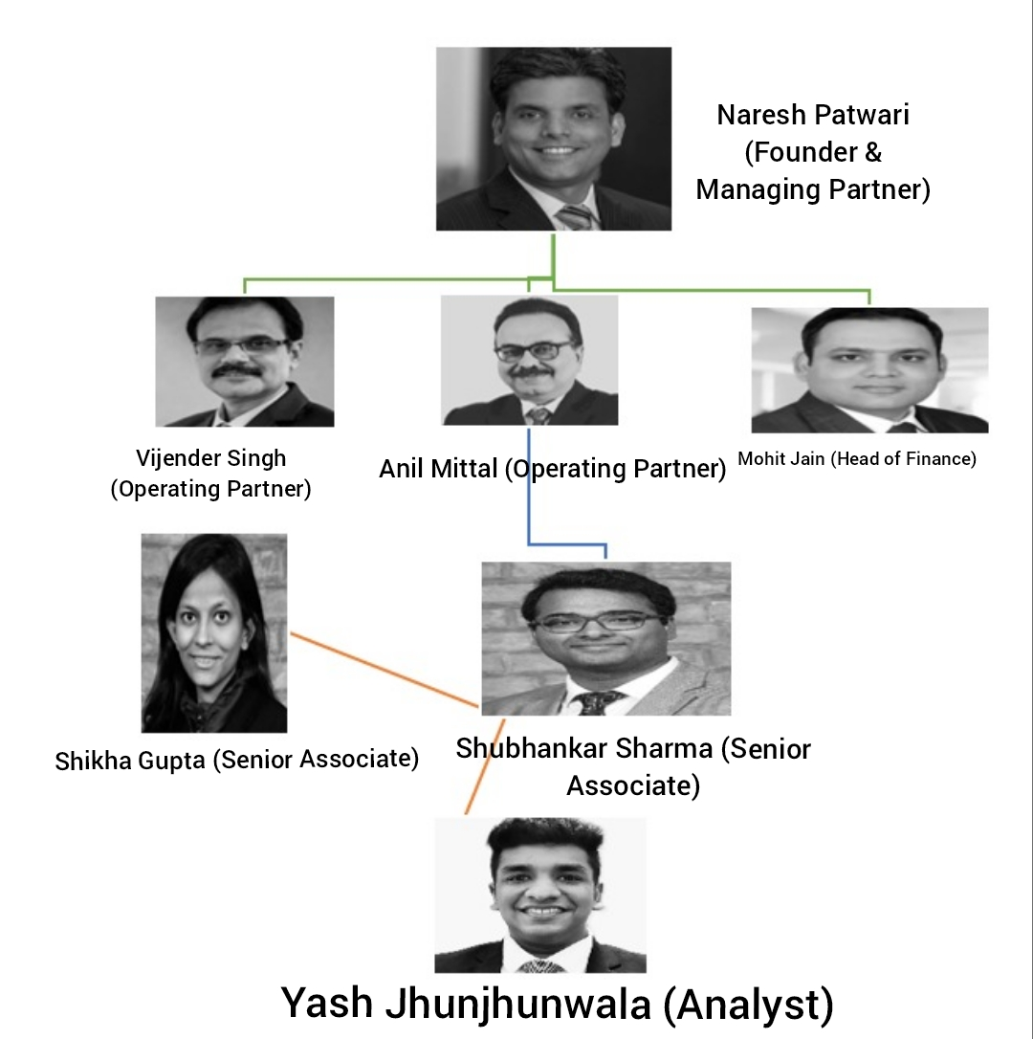
CONTINUED
Some of the companies that Jashvik Capital has invested in include Jabsons Foods Pvt. Ltd, an ethnic savory snacks company based in Bharuch, Gujarat.
The company is flexible about deal size and is willing to invest from $10 million to $50 million from its funds.
Organizational structure at Jashvik Capital
Notes:
https://www.vccircle.com/jashvikcapital-hits-first-close-of-maiden-fund
Naresh Patwari is the founder and managing partner of Jashvik Capital. Vijender Singh and Anil Matai are operating partners of the company. Zeffirra is the AVP of Fund Operations at Jashvik Capital.

Slide 24
OUR CONTRIBUTION
S.NO | EXPERT NAME | RELEVANT CURRENT DESIGNATION & COMPANY
1. | Sanjeev Wadhwa | President Sales at Bikano
2. | Manoj Verma | COO at Bikaji Foods International
3. | Pramod Thampi | Vice President - Domestic & International Business at Gopal Snacks
4. | Tyron Doll | Vice President & Head - Sales at Haldiram
5. | Deepak Kumar | Sales Head at DFM Foods

Slide 25
WHO CAN BE OUR POTENTIAL CLIENTS
HarbourVest Partners:
HarbourVest Partners is a global private equity firm that was founded in 1982. As of September 30, 2021, the total assets under management (AUM) of HarbourVest Partners was approximately $90 billion.
There noticeable investments in India: Byju’s: In 2018, HarbourVest Partners invested $50 million in Byju’s, an edtech company that provides online learning solutions to students in India.
BigBasket: In 2017, HarbourVest Partners participated in a $280 million funding round for BigBasket, an online grocery delivery platform in India.
2. New Enterprise Associates (NEA):
New Enterprise Associates (NEA) is a global venture capital firm that was founded in 1977.
As of September 2021, New Enterprise Associates (NEA) has over $24 billion in assets under management (AUM).
There noticeable investments in India:
Swiggy: NEA invested $15 million in the food delivery startup in 2015, and has since provided additional funding as the company has grown. Swiggy is now one of the leading food delivery platforms in India, with a presence in more than 500 cities.

Slide 26
CONTINUED
3. Baring Private Equity Asia (BPEA):
Baring Private Equity Asia (BPEA) is one of the largest and most established private equity firms in Asia, with a focus on mid-market investments.
As of September 2021, Baring Private Equity Asia (BPEA) has over $20 billion in assets under management (AUM). There noticeable investments in India:
Hexaware Technologies: BPEA acquired a majority stake in Hexaware Technologies, an IT and business process outsourcing company, in 2013. The company was later sold to French IT services firm Capgemini in 2021.
4. CVC Capital Partners:
CVC Capital Partners is a private equity and investment advisory firm founded in 1981. As of September 2021, CVC Capital Partners had approximately $118 billion in assets under management (AUM).
There noticeable investments in India:
PVR Cinemas: In 2018, CVC Capital Partners acquired a 10% stake in PVR Cinemas, a leading cinema chain in India, for approximately $72 million.

Slide 27
CONTINUED
5. Summit Partners:
Summit Partners is a global private equity and venture capital firm founded in 1984. As of 2021, Summit Partners has approximately $28 billion in assets under management (AUM).
There noticeable investments in India:
Zenoti: A software platform that provides management solutions for spas, salons, and fitness centers. Summit Partners invested $50 million in Zenoti in 2021.

Slide 28
SUGGESTIONS:
1. ENHANCE TECHNOLOGY PLATFORM:
Conduct call on our platform, send messages to expert on festivals and their birthdays so they remember us and feel conducted. Also create a payment tracker system for the experts to track there payments.
2. LEVERAGE DATA ANAYTICS:
Infollion can leverage data analytics to provide clients with deeper insights and trends analysis. Use search engine optimization (SEO) techniques to improve their website's visibility on search engines and invest in paid advertising campaigns to reach their target audience.
3. IMPROVE SOCIAL MEDIA PRESENCE AND CONDUCT SEMINARS:
We should make Infollion the first thing which comes to the mind of a person when they think of expert network. We should spread more awareness about our industry and what we do.

Slide 29
Thank You. Up for Q and A.

